Slide 1

Unit 3: Lesson 3 How self-reliant are you?
U ovoj ćeš lekciji upotrijebiti glagolsko vrijeme the present perfect continuous u kontekstu važnosti bavljenja sportom.

Slide 2
Open your book, page 54
Task 1: Read and translate the saying.
Task 3: Answer the questions and find out how self-reliant you are.
Task 3: Check your results and write a report.
Example:
I have been cooking since I was 10.
I have been buying groceries since I was 11.
I have been changing lightbulbs for two months now.
I have been cleaning the house for two years.
Očekuj manje od drugih, a više od sebe.

Slide 3
Task 5: Read the text. Is Lucas self-relient?
Task 6: What has Lucas been doing…
Lucas has been doing wall climbing since he was 6.
He has been making shopping lists, buying groceries and cooking since he was 11.
He has been cleaning their flat and doing laundry for as long as he can remember.
He has been going to the gym by himself since he was 10.
He has been preparing for the regional competition for the last couple of months.

Slide 4
Zapiši u bilježnicu:
Present perfect continuous
We use the present perfect continuous to talk about an action that started in the past and continues up to the present moment.
I/You/We/They have been living in London since 2014. (I/You/We/They still live there.)
He/She/It has been waiting for hours. (He/She/It is still waiting.)

Slide 5
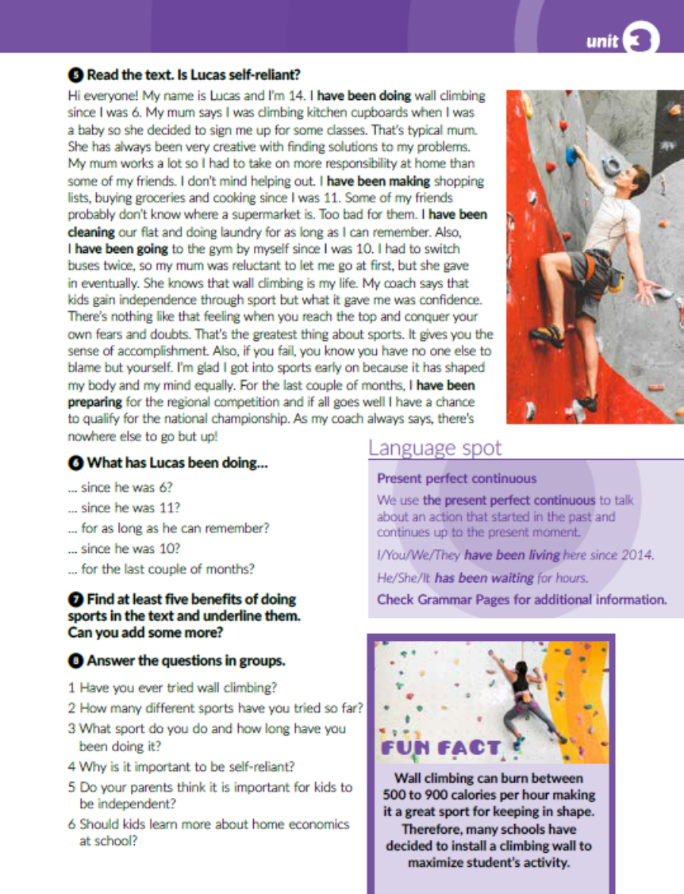
Task 6: Find at least five benefits of doing sports in the text and underline them.

Slide 6

Task 8: Answer the questions.
1. Jesi li se ikada bavio/la penjanjem?
2. Koliko si različitih sportova probao/la do sada?
3. Baviš li se nekim sportom i koliko dugo?
4. Zašto je važno biti samostalan?
5. Smatraju li tvoji roditelji da djeca trebaju biti samostalna?
6. Trebaju li djeca učiti više o vrijednosti novca i ekonomiji u školi?

Slide 7
Open your workbook, page 55
Task 1: Guess the word.
i g h t b u l b
u t t o n
u i t c a s e
a n d A i d
r o c e r i e s
h o p p i n g l i s t
i n d e p e n d e n t

Slide 8
Task 2: Match the sports to their definitions.
3
7
8
4
2
9
6
5

Slide 9
Task 3: Which sport would you recommend to… Koji bi sport preporučio nekome tko…
… voli provoditi vrijeme u prirodi?
… voli plivati?
… ima puno pustolovnog duha?
… voli biti dio tima?
… pokazuje interes za Japansku kulturu?
… je umjetnički nastrojen?

Slide 10
Task 4: Complete the sentences with since or for.
for
since
for
since
since
since
for

Slide 11
Task 5: Complete the text with the present perfect continuous tense of the verbs in brackets.
have been meaning
have been suffering
haven’t been exercising
have been preparing
haven’t been eating
sleeping
have been overworkng
have been stressing
have
been working
have been running
have been trying

Slide 12
Task 6: Present perfect simple or continuous? Circle the correct answer.

Slide 13

Otvori sljedeću poveznicu, te odaberi PLAY AND LEARN!
https://www.e-sfera.hr/dodatni-digitalni-sadrzaji/b38ac2b1-2462-4e52-897b-44bd79b900c2/

